Slide 1
Functional Programming

Slide 2
Is functional programming ..
Writing functions ?
Using functions as in imperative/OO languages ?

Slide 3
Imperative Languages
programs execute commands sequentially,
use variables to organize memory,
update variables with assignment statements.
The result of a program thus comprises the contents of all permanent variables (such as files) at the end of execution

Slide 4
Cont..
Execution speed is limited by the speed with which individual instructions can be executed
to know the state of a computation, one must know the values of all the variables.
Notes:
Do not lend themselves to simultaneous execution of different parts of the program, because any command may depend on the changes to variables caused by previous commands

Slide 5
Programming Paradigms
Procedural programming
Decompose program into procedures
Procedures work on data and modify the “state” of the data
Object oriented
Decompose program into data “types”/classes
Data objects talk to each other

Slide 6
Functional Programming
no variables, no assignment statements, and no iterative constructs.
Based on the concept of mathematical functions like :
f(n) =
1 if n = 1
f(3*n+1) if n is odd , n != 1
f (n/2) if n is even

Slide 7
Cont..
Mathematical definitions are converted directly into syntax of language
Entire program is simply a function which itself is defined in terms of other functions

Slide 8
Cont...
n is not a variable its identifier
Identifier is bounded to a value
Identifiers generally acquire values through parameter binding.
Notes:
No variables because the result of one function is immediately passed as a parameter to another function. Because no variables are used, it is easy to define the effects (that is, the semantics) of a program
No side effects : compute results without updating the values associated with variables.

Slide 9
Cont...
Variables are unnecessary
Easy to define sematics
Functions have no side effects

Slide 10
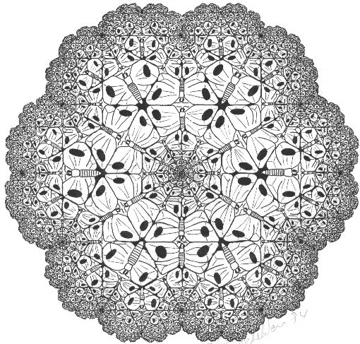
Cont...
Fractal
Ref : http://classes.yale.edu/fractals/

Slide 11
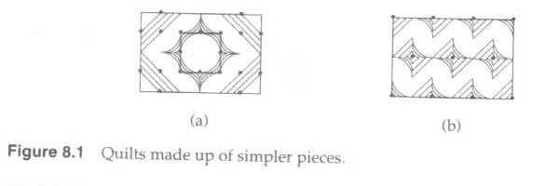
A Little Language of Expression
The little language ----Little Quilt
small enough to permit a short description
different enough to require description
representative enough to make description worthwhile
Constructs in Little Quilt are expressions denoting geometric objects call quilts:

Slide 12

Cont ..
What Does Little Quilt Manipulate?
Little Quilt manipulates geometric objects with height, width and texture
Basic Value and Operations:
The two primitive objects in the language are the square piece.

Slide 13
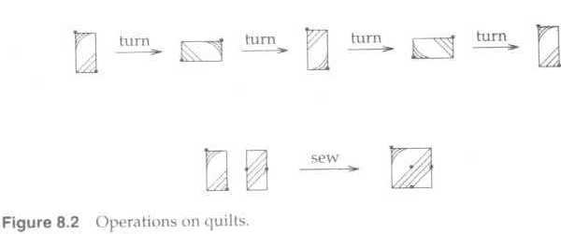
Cont ...
The operation are specified by the following rules:
A quilt is one of the primitive piece, or
It is formed by turning a quilt clockwise 90°, or
it is formed by sewing a quilt to the right of another quilt of equal height.
Nothing else is a quilt.

Slide 14
Cont...
Constants:
Names for basic values: the pieces be called a and b
Names of operations: the operations be called turn and sew. (like the picture on the previous slide)
now that we have chosen the built-in object and operations (a,b, turn, sew) expressions can be formed
<expression>::=a | b | turn(<expression>)
| sew (<expression>,<expression>)

Slide 15
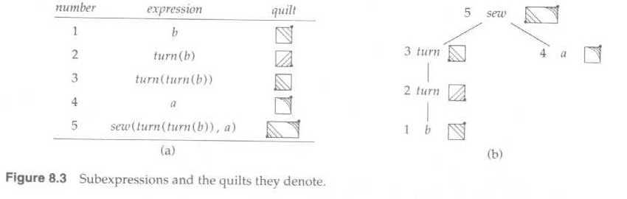
Cont ...
Example: sew(turn(turn(b)),a)

Slide 16
Cont ...
User-Defined Functions
Some of the frequent operations are not provided directly by Little Quilt.
These operations can be programmed by using a combination of turning and sewing.

Slide 17
Cont ...
User-Defined Functions
Examples:
unturn -- turning a quilt counterclockwise 90°
fun unturn(x)=turn(turn(turn(x)))
pile -- attaching one quilt above another of same width
fun pile(x,y)=unturn(sew(turn(y),turn(x)))

Slide 18
Cont ...
Local Declarations
Let-expressions or let-bindings allow declarations to appear with expressions.
The form is:
let <declarations> in <expression> end

Slide 19
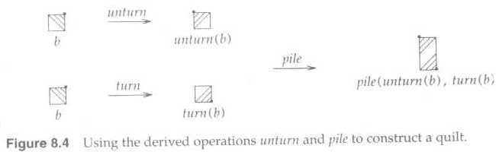
Cont ...
Example:
let fun unturn(x)=turn(turn(turn(x)))
fun pile(x,y) =unturn(sew(turn(y),turn(x)))
in pile (unturn(b), turn(b))
end

Slide 20
Cont ...
User-Defined Names for Values:
To write large expressions in terms of simpler ones.
A value declaration gives a name to a value
val <name> = <expression>
Value declarations are used together with let-bindings.
let val x=E1 in E2 end
occurrences of name x in E2 represent the value of E1

Slide 21
What does the quilt look like?
Let fun unturn(x) = turn(turn(turn(x)))
fun pile (x,y) = unturn(sew(turn(y),turn(x)))
val aa = pile(a, trun(turn(a)))
val bb = pile(unturn(b),turn(b))
val p = sew(bb,aa)
val q = sew(aa,bb)
in
pile(p,q)
end
Refer : Ravi Sethi (PL- chapter 8)

Slide 22
Functional Programming in Python

Slide 23
Sequences
Strings
List
Tuple
Dictionary

Slide 24
Iterators
>>> s = “hello”
>>> it = iter (s)
>>> print it
>>> it.next()
???
>>> l = [1,2,3,4]
>>> it = iter(l)
>>>max(it)
>>> lt = (1,2,3,4,5)
>>> it = iter (lt)
>>> min (it)

Slide 25
Cont ...
Are next() , max () , min() functions ?
What do they do ?
Do they change/modify the sequence ?
Operators like “in” , “not in”

Slide 26
Question of the day
Can files support iteration ?

Slide 27
Common Operations on Iterator's Output
Perform some operation for every operation
Selecting subset of elements that meet some condition

Slide 28
List comprehensions and generator expressions
Concise notation for common operations on iterator
List comprehension : [ ]
[expression for expr in seq]
Generator expressions : ( )
(expression for expr in seq1
If cond1
for expr in seq2
If cond2
)

Slide 29
What is the output ?
>>> line_list = [' line 1\n','line 2 \n']
>>> for line in line_list :
line.strip()

Slide 30
Generator Expression
>>> stripped_iter = (line.strip() for line in line_list)
Generator expressions returns iterator

Slide 31
List Comprehension
>>> stripped_list = [line.strip() for line in line_list]
List comprehension returns a list

Slide 32
Example 2
>>> seq1 = 'abc'
>>> seq2 = (1,2,3)
>>> [(x,y) for x in seq1 for y in seq2 ]

Slide 33
Generators
In imperative/OOP what happens to return value of a function ?
def generate_ints(N):
for i in range(N):
yield i
Any function containing a yield keyword is a generator function

Slide 34
Lambda Calculus
Example 1 : f(x) -> x*x
Example 2 : f (x) -> 1 for x <=1
-> x*f(x-1) for x = 2,3,4.....
Example 3 : f (x,y) -> x+y

Slide 35
Lambda Functions
>>>lines = [' line 1 \n','line 2 \n']
>>> [line.strip() for line in lines]
?????
Can we write some function like : f(lines) which will give us above output ?

Slide 36
Lambda Function
<function_name> = lambda expr : List Comprehension or generator expression
>>> gstrip = lambda lines : (line.strip() for line in lines)
>>> gstrip
????
>>> lstrip = lambda lines : [line.strip() for line in lines]
????
>>>lstrip

Slide 37
Lambda Function examples
Sqaure of x
Cube of x

Slide 38
Factorial
Recursive version :
fact (n) :
if n<=1 :
return 1
else :
return n*fact(n-1)
We cant write this as lambda function since this function has if/else statement
Lambda functions have only expressions with for

Slide 39
Cont ...
Use ternary operator with short circuiting
Ternary operators :
x = trueValue if condition else falseValue
score = int(ss) if ss != ’AA’ else 0
print "The temperature is %s freezing." % ("below" if temp < 32 else "above")

Slide 40
Lambda Function for Factorial
f = lambda x : x and x*f(x-1) or 1

Slide 41
Lambda Function for Fibonacci sequence

